Slide 1
Predicting the Future Batting Average of MLB Players
Thomas McMahon

Slide 2
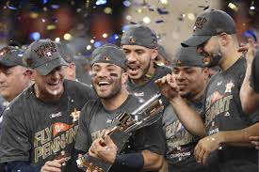
The Problem
Baseball teams have always been trying to find new ways to be able to outperform other teams in order to win more games with the goal of winning the world series. Most of the time this is done by spending more money, but what if there was a better way to predict a players future performance.(No trashcans needed)

Slide 3



Who would want this

Slide 4
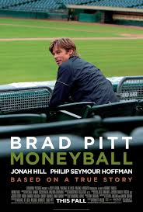
Why would people care
Because It has been used before
Over the past decade sports have become much more data driven, none more than baseball. In sports to gain the upper hand over your opponents you either need to have deeper pockets than them, or you can be smarter than they are. This second idea is the option that the Oakland Athletics needed to choose in order to compete with bigger market teams such as the New York Yankees. How they accomplished that is through the use of data. Former professional baseball player turned manager Billy Bean after losing another star player to money decided to change the way a team could be put together. With the help on analysts, he determined that he was going to put the cheapest team on the field with the highest on base percentage.

Slide 5
Data Information
The data was that was used was from the time period of 1970-2015
The data was all of the batting stats for all players in the MLB
Number of records: 19853
The data was from https://www.kaggle.com/open-source-sports/baseball-databank

Slide 6
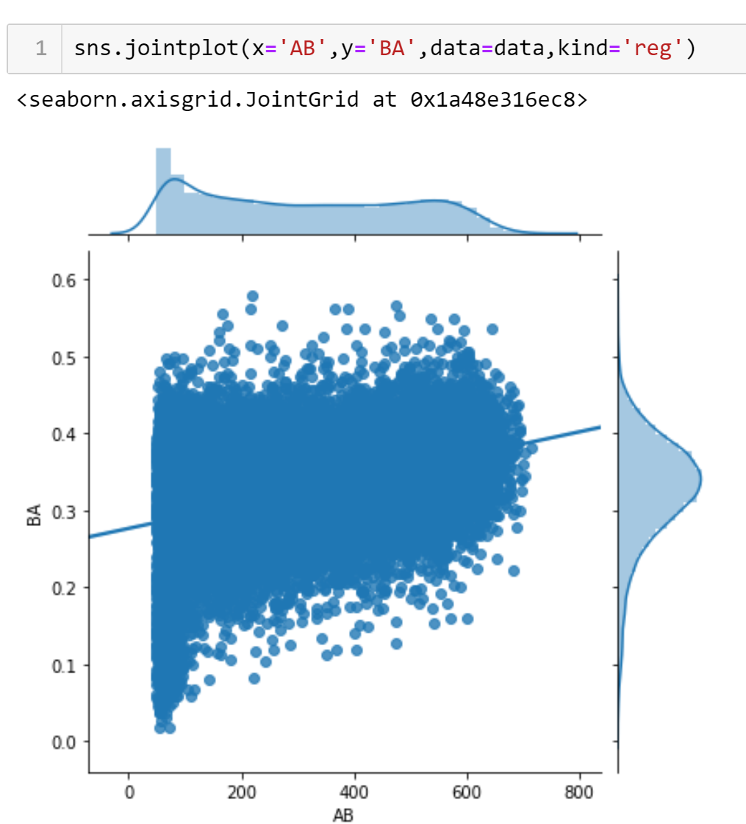
Problem Features
One of the things that I noticed right away when looking at the trends in the columns that were in the data were that as expected as the total number of hits increased in general so did the batting average. But a problem that I quickly saw with that relationship was how wide of a range there was in at bats and batting average when it came to players with very few at bats. This makes sense because the data have every player with at least one at bat so if that one at bat was a hit it registered as the player having a batting average as 100% and the opposite was true with the player have a batting average as 0%. This lead to the decision of removing any player that had less than 50 at bats during a season, this was a judgment call on the number of at bats. I chose 50 because while it still had the widest spread in batting average by far, I didn’t want to remove too much data that could change the predictions of the models I would be building.

Slide 7
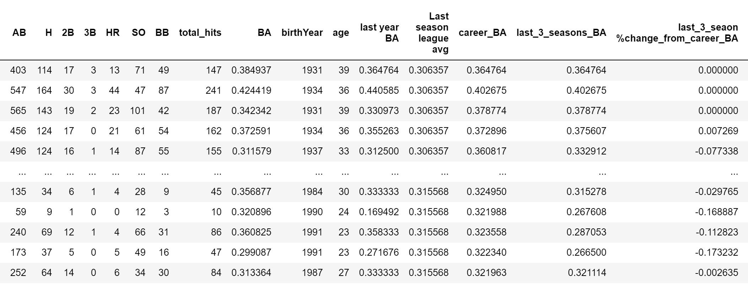
Creating all the Features
Features Created
Batting Average
League Average
Last Seasons Average
Career Average
Last 3 seasons Averages
Precent Change from Career Average
Last 3 Seasons Change from Career Average

Slide 8
Trends
I felt that just having the stats for a given season and the next seasons batting average was not going to be enough. That is why I built features that would take a rolling average of the past three seasons batting averages. This information would be able to see if the player was in some sort of hot streak or slump. I felt that this in addition to other basic stats will be able to help the model make better predictions.

Slide 9
Precent change
The last features that were added to the model were features that looked at how both last seasons batting average and the last 3 years trend compared to the players career batting average. I felt that this would help the show the model how the well the player batted compared to there statistical normal. I was hoping to have the model be able to find if and how the smaller sample of recent at bats would compare to all of there at bats, and see if maybe more recent at bats matter more than just their career statistic.

Slide 10
Modeling Overview
The models were built using Supervised learning
Because I was looking for the batting average the models were regression models
I used scikit learn inside python to build the models

Slide 11
Modeling Types Used
The two types of models that I built were Linear regression and random forest models.
I used the linear regression as a baseline for predictions, but soon learned that the relationships between the variables were much to complex for a linear model to properly predict them.
I then used a random forest because it gave me the ability to used many individual models, and take advantage of bootstrapping to have the model learn from each individual tree that was created.

Slide 12
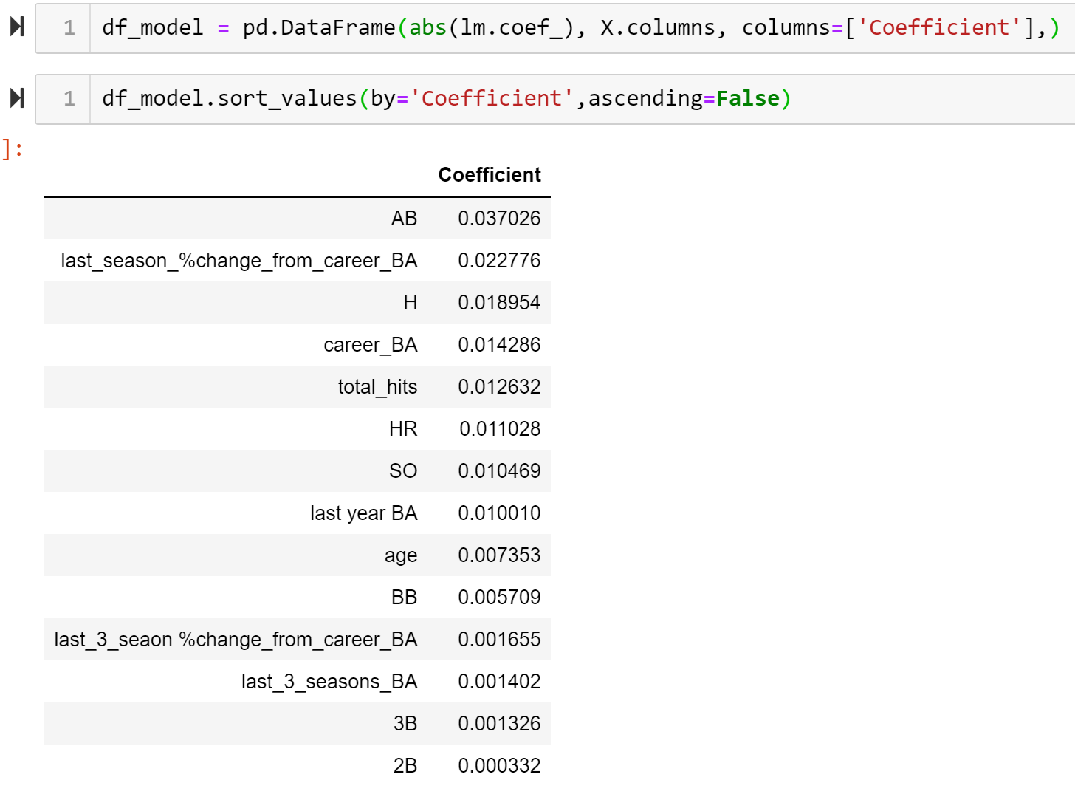
Linear Regression
When running the linear model I found that the model wasn’t doing a very good job of making the predictions. I was getting a mean absolute error of roughly .043 witch seems small, but is the difference between a slightly below average batter and a player contending for the batting title for most seasons. The models were taking into account all the features, but seeing that the feature with the highest coefficient was at bats I knew that this model was not the answer.

Slide 13
Random Forest Regression
The reason that I felt that a random forest would be able to produce a better model was the fact that it is a model built from many models. This means that it starts with a very basic decision tree checks the answers and learns from its mistakes, and moves on to the next model. Although these models did out preform their linear counterparts it was not to the extent that I would have liked. I was able to reduce the mean absolute error to .04.

Slide 14
Conclusion
The models that I was able to produce did have some value when it comes to making predictions on a players future prefromance, but is a long way from perfect. Based on the models there was not much of a difference between the models and just assuming that each player would bat at the same level that thaey have throughout their career. Having said this the model is still something that is much better than the days of using other factors such as how hot the players significat other is to see how confident they are. Billy Bean was able to prove that using the data on past performance is vital and useful when trying to put togther a competitive team on the field, especially on a budget.

Slide 15
Future Improvements
In my mind these models are works in progress. There were some features that I had no acess to that had the possibility to make the model better, such as the handedness of the bater, and the breakdown on how many pitchers pitch righthanded vs lefthanded.As sports become more data driven new stat categories will be tracked, and I very much feel that these new features will be able to help make better predictions when it comes to future performance in numerous categories.

Slide 16
Thank You
Any Questions?

